Slide 1

2011 年回顧
2011 Highlights
光鹽社
Light and Salt Association

Slide 2
2011 年回顧
2011 Highlights
光鹽社
Light and Salt Association

Slide 3
信心、愛、關懷
Faith、Love、Care

Slide 4
Milestones (重要哩程碑)
    1997 – Founded (成立)
    2001 - Cancer Support Network (癌友關懷網)
    2006 - Radio Program (心靈加油站)
    2007 - Breast Cancer Support Program (乳癌互助小組)
    2008 - Special Needs Care Center
    (特殊關懷中心)
    2008 - Radio Program: Cantonese (粵語飛揚)
    2011 – Northwest Branch Office
    (西北辦事處)
    2011 –Veggie Farm (蔬菜園地)
    2011 – Family Care (家庭關懷)
Notes:
西北辦事處

Slide 5

Light and Salt Association
Cancer Support Network

Slide 6
專題講座及一般互助小組
Cancer Seminars & General Cancer Support Group Meetings

Slide 7
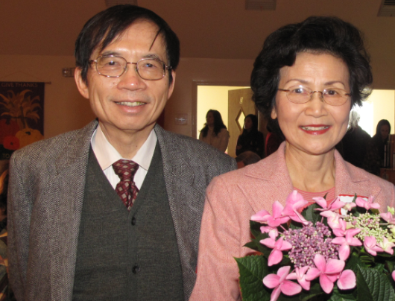
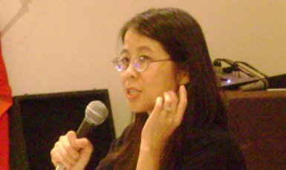
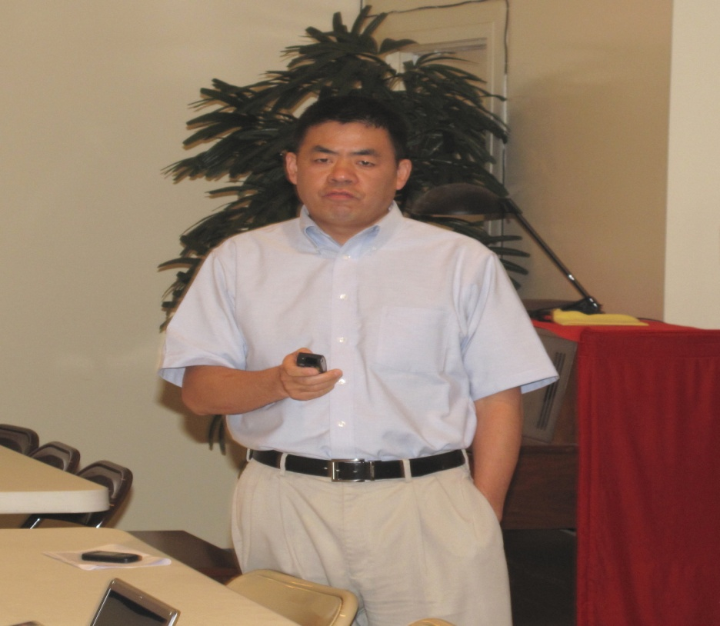
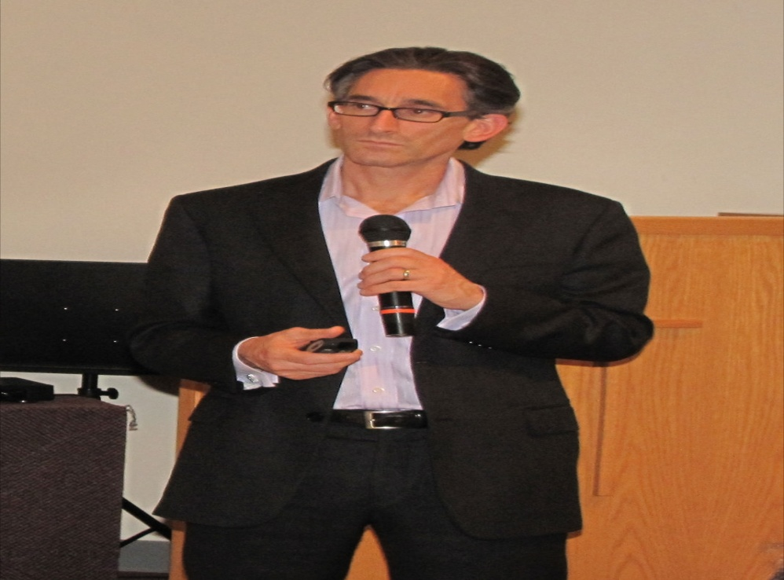
胡桂英醫師 (Dr. grace Hu),
St. Lukes Hospital / Kelsey- Seybold Clinic
講員 陳康元醫師 和王琳博士
Speakers: Drs. Karl and Grace Chen
陳康元醫師和王琳博士
Dr. Lorenzo Cohen 博士, University of Texas MD Anderson Cancer Center
殷正男醫師 (Dr. Zhengnan Yin, CI Medical Center

Slide 8
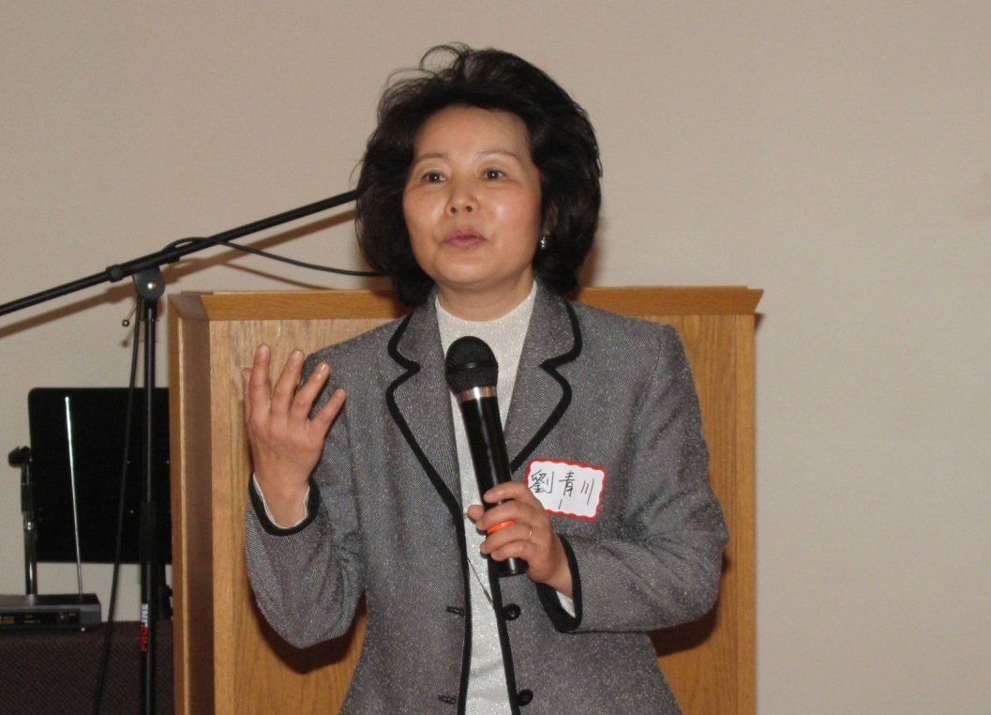
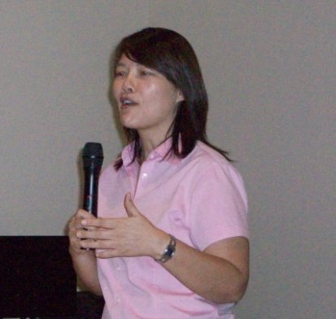
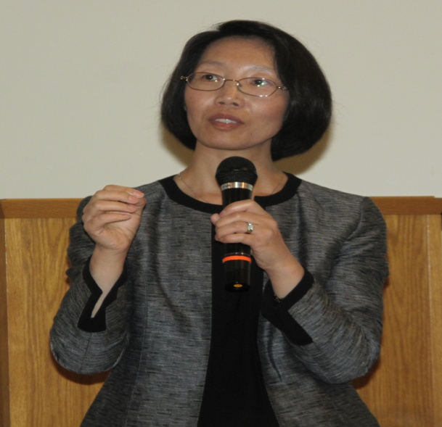
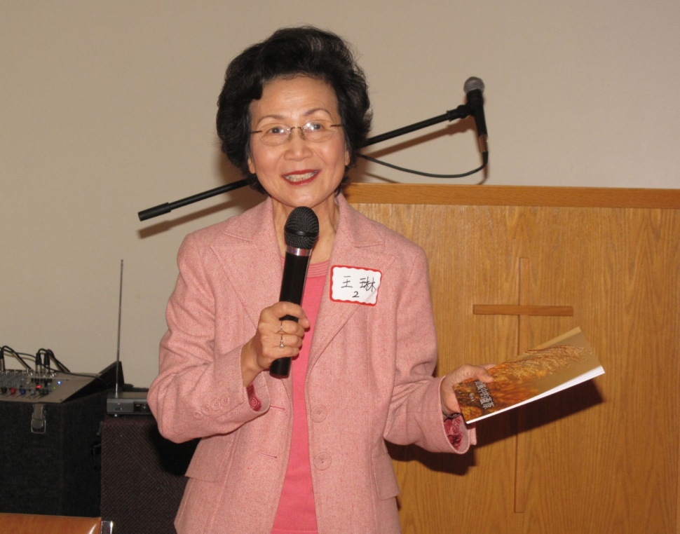
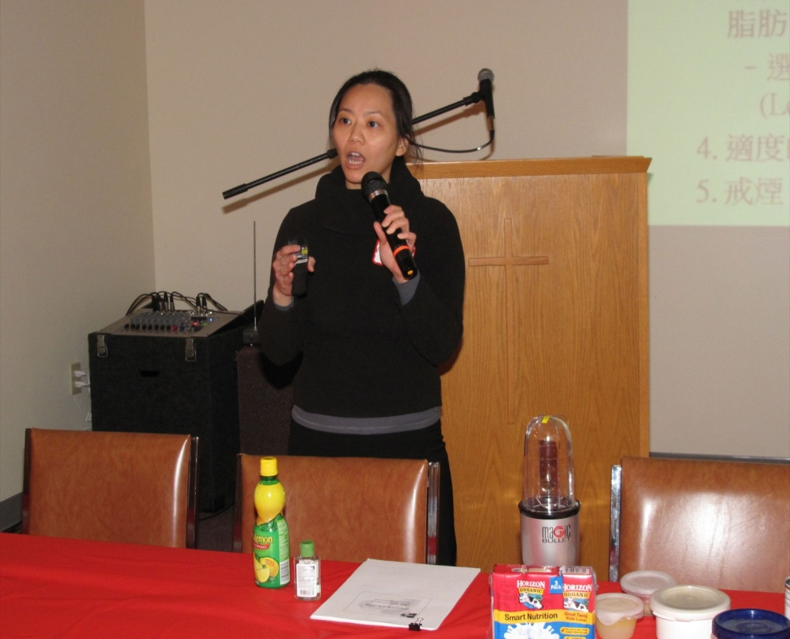
劉青川中醫師 (Kathy Liu, CMD)
呂乃琳中醫師
(Niling Lu, CMD)
楊培英博士(Dr. Penying Yang), The University of Texas MD Anderson Cancer Center
王琳博士 (Dr. Grace Chen)
張慶怡營養師
(Ms. Maria Chang, RD)

Slide 9
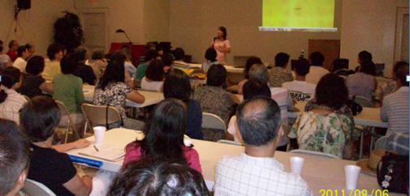
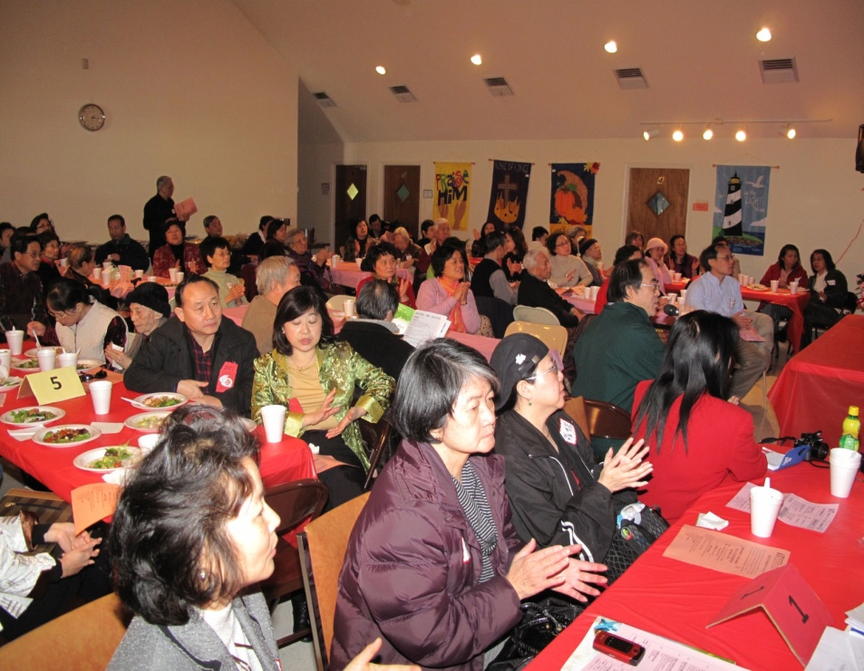
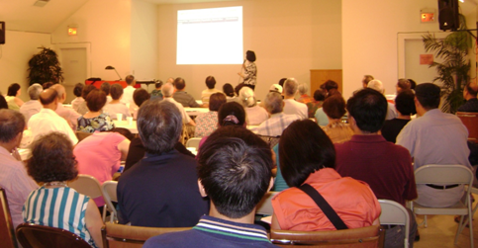
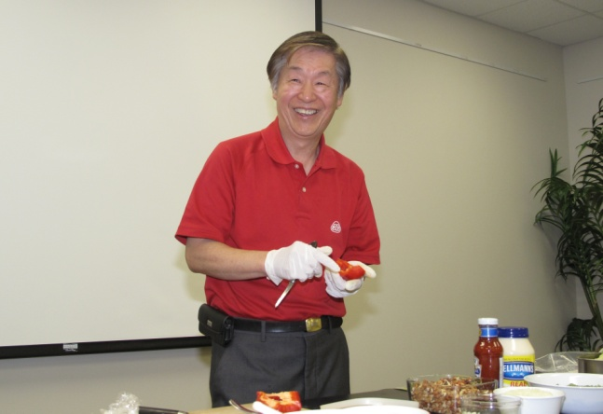
Cancer Seminars
陳德新老師,養生食譜示範
(Mr. Chen Healthy Cooking Demonstration

Slide 10
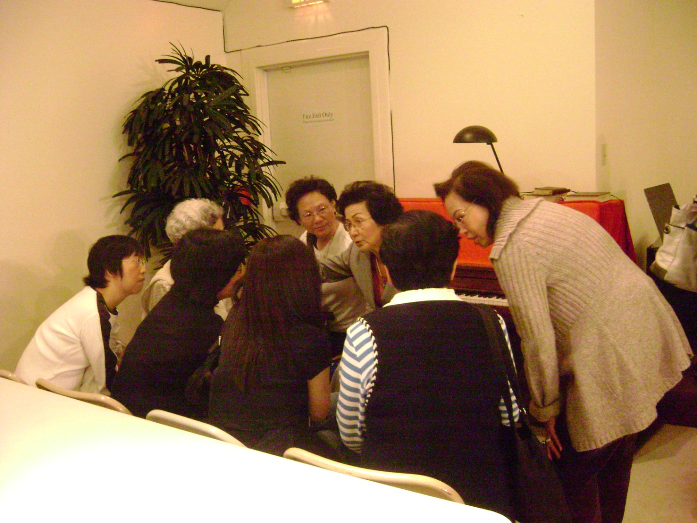
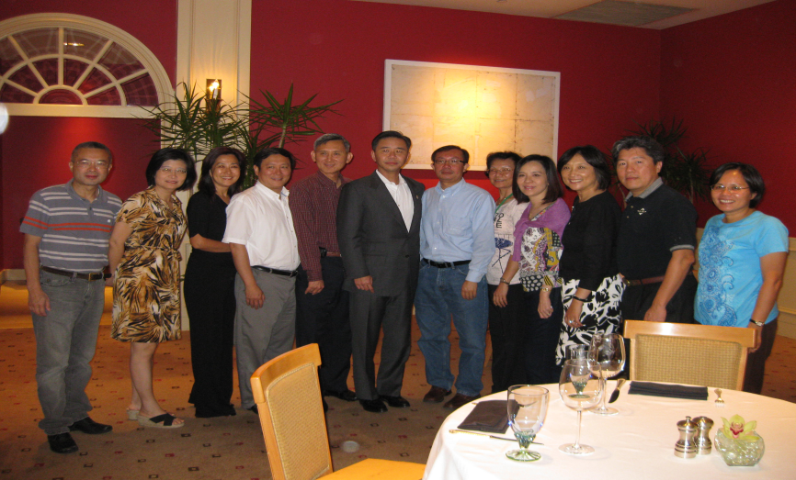
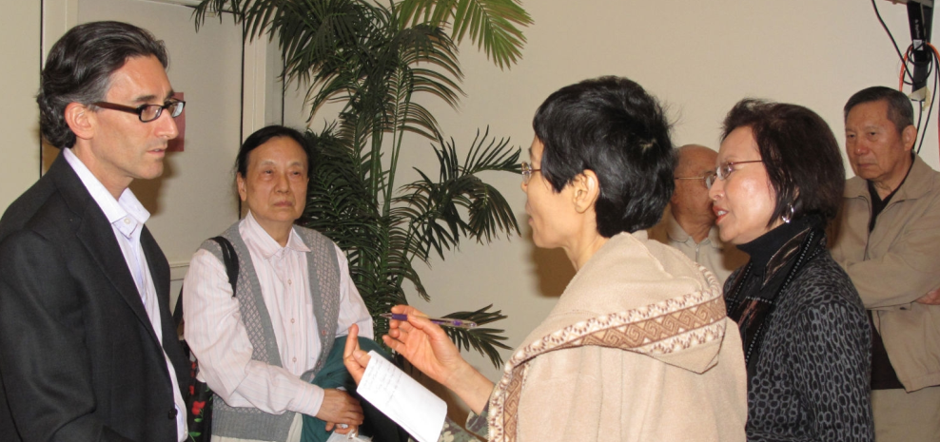
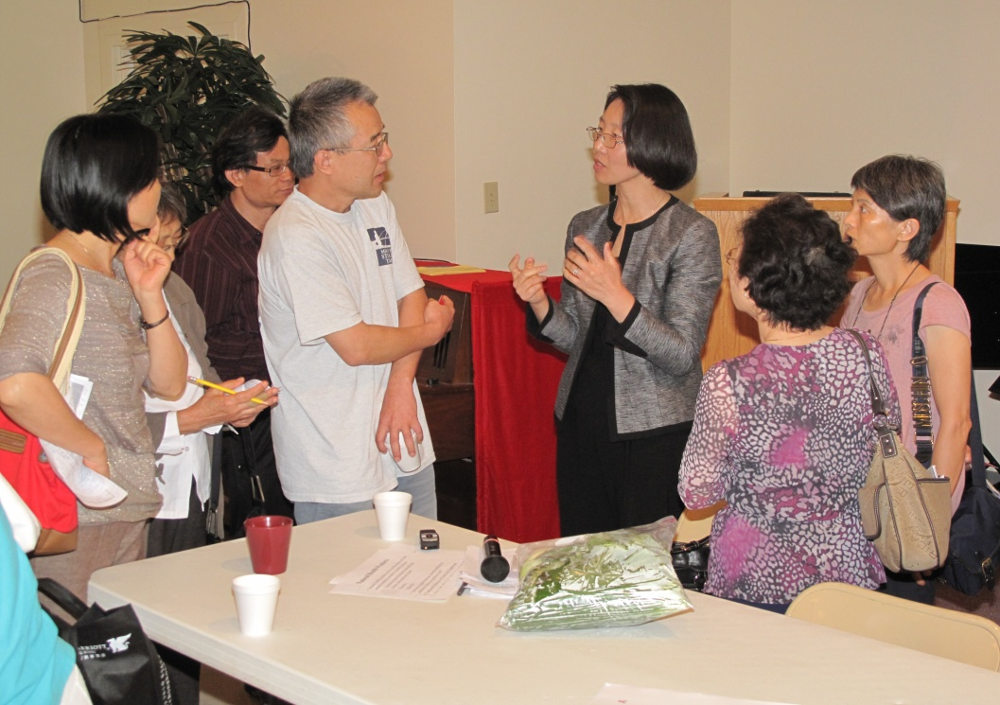

Slide 11
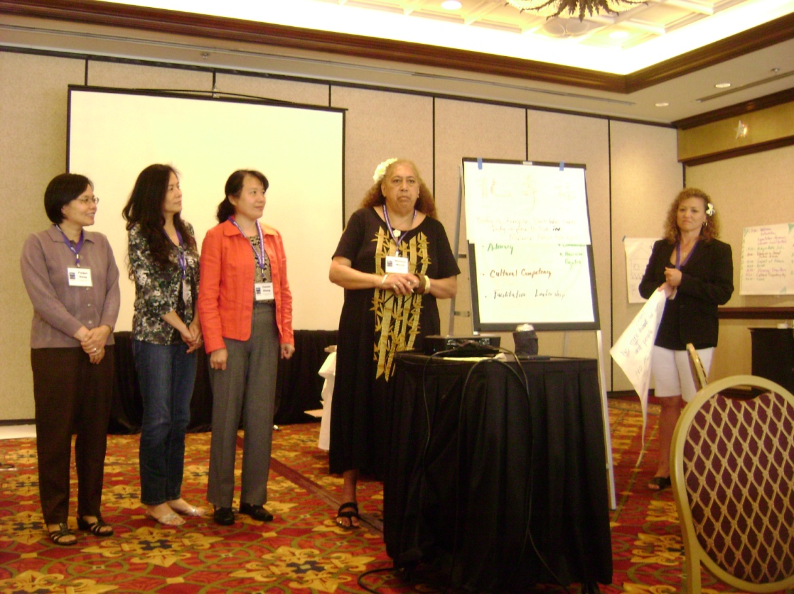
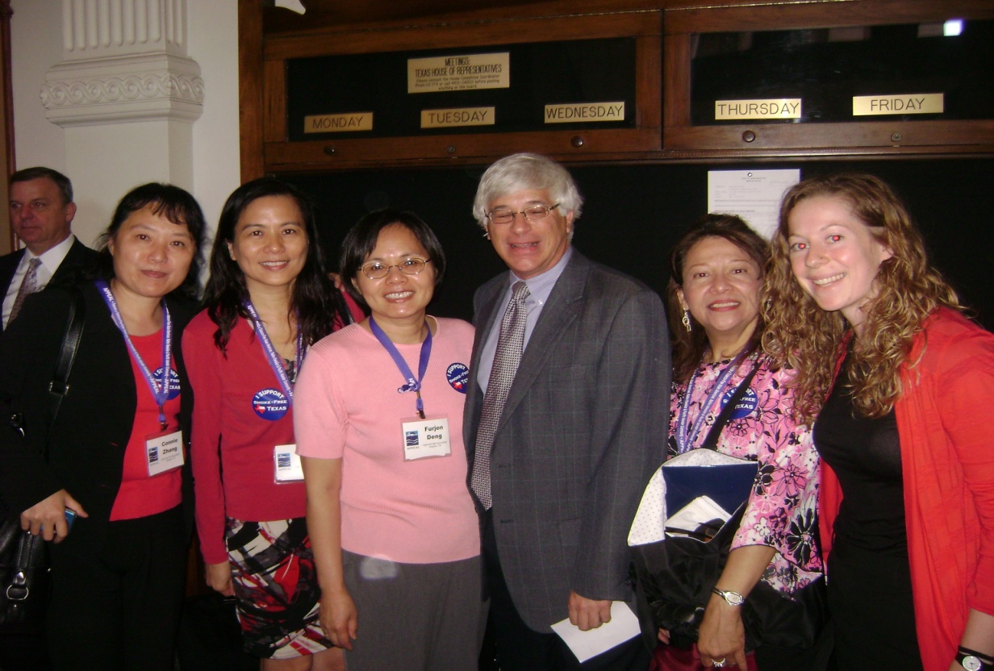
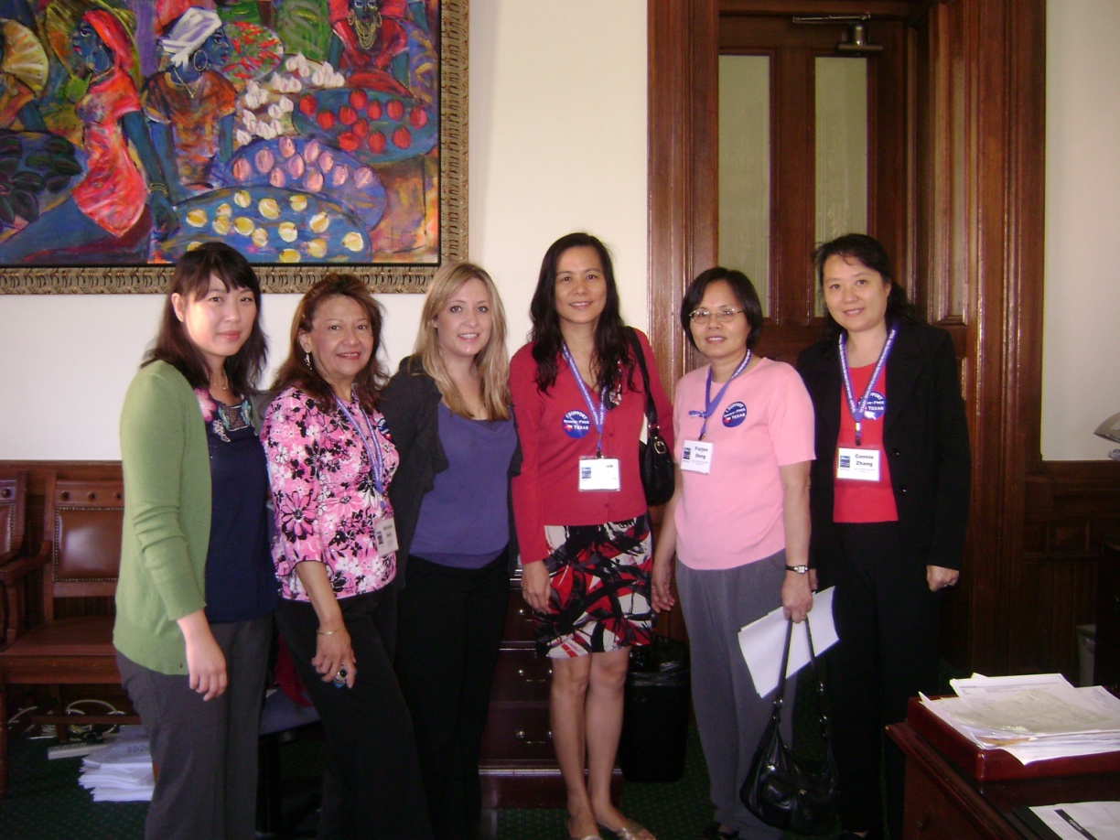
5月25日至26日, 参加 Texas Tobacco and Health Disparities Leadership Training for Latino, Asian Americans and Pacific Islander Communities.
拜訪州議員 Scott Hochberg

Slide 12
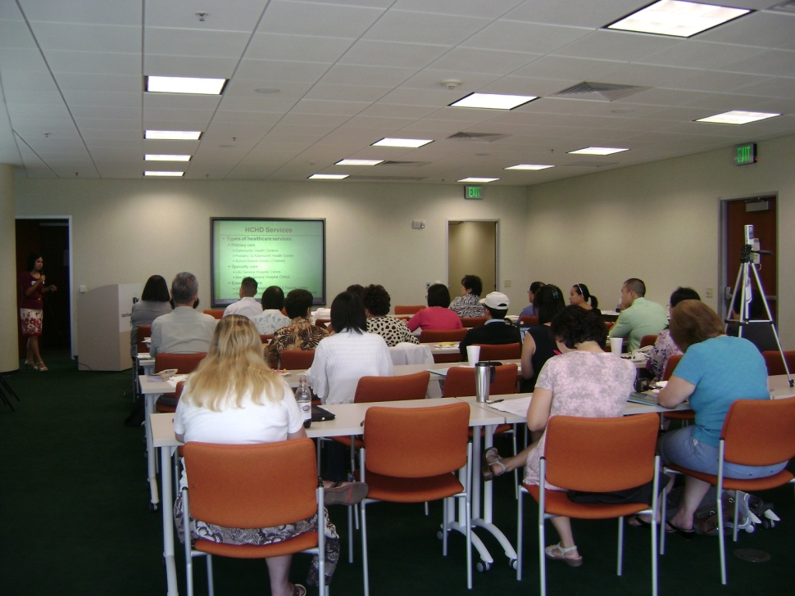
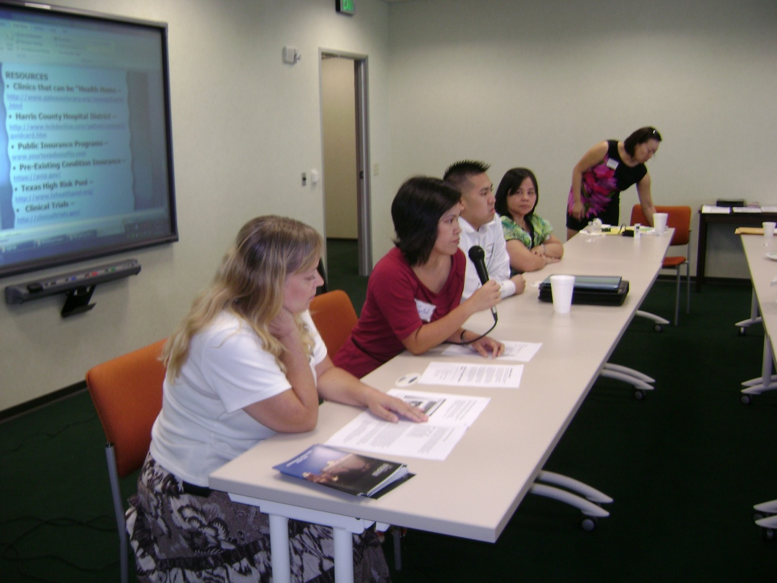
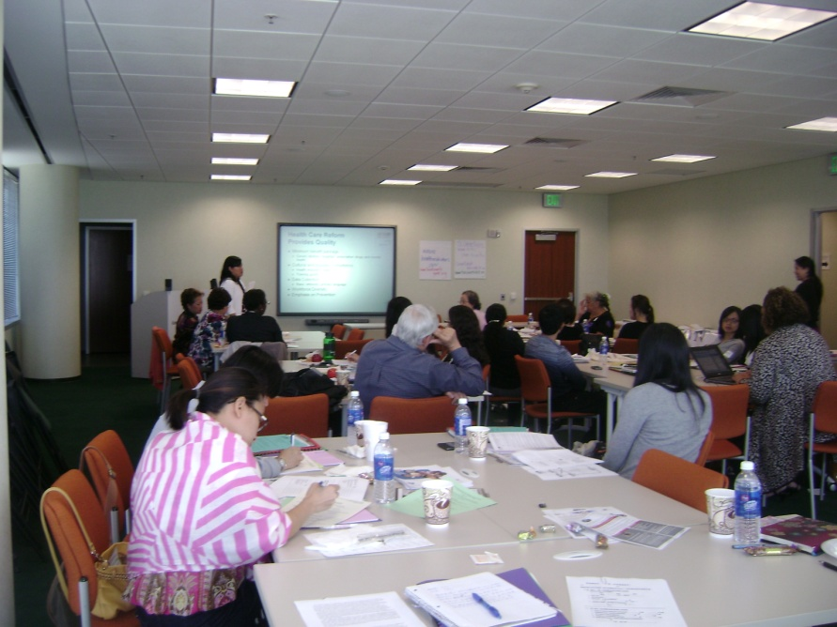
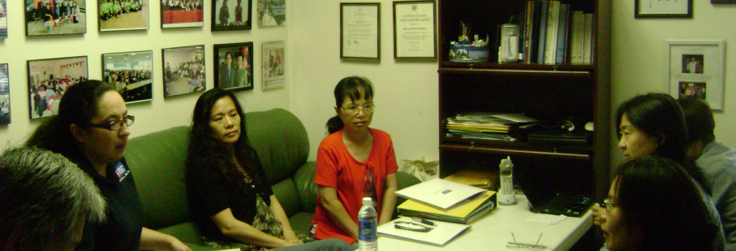
8月19日光鹽社, 。 亞裔防癌協會與希望診所聯合舉辦癌症醫療保險訓練 (Patient Navigation Training Workshop, Cosponsored with Asian Cancer Council, and Hope Clinic)
訓練營 (Trainings)
4月14至16日，光鹽社與希望診所，恆豐銀行和美國亞太裔倖存者聯盟，聯合舉辦為期兩天半的CATCH Leadership培訓營 (Co-sponsored with Hope Clinic and APICSN)
ACS-戒煙課程訓練 (Smoking Cessation Training)

Slide 13

光鹽社乳癌互助小組
乳癌互助小組
(Breast Cancer Support Group)

Slide 14
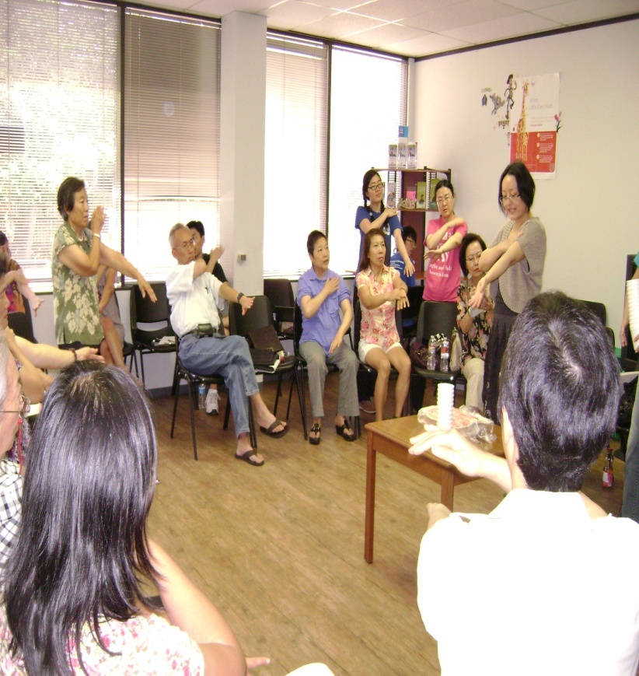
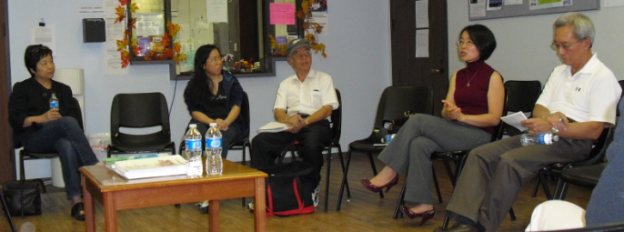
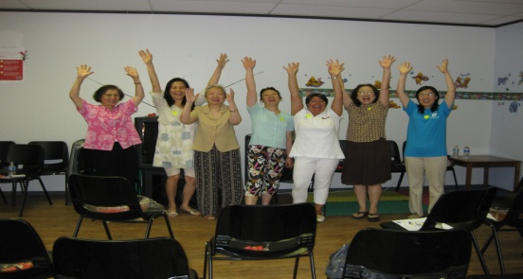
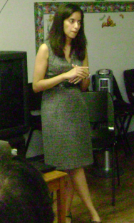
月聚會 (Support Group Meetings)
馬濤中醫師 (Ma Tao, CMD)
Dr. Polly A. Niravath, Baylor College of Medicine

Slide 15
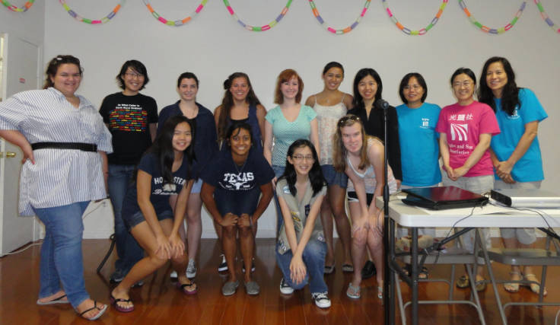
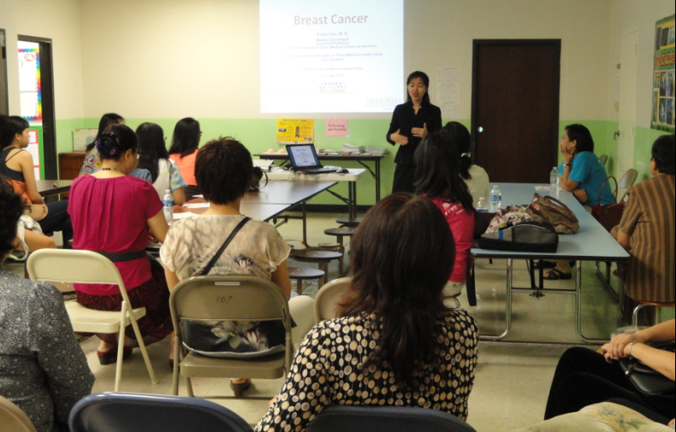
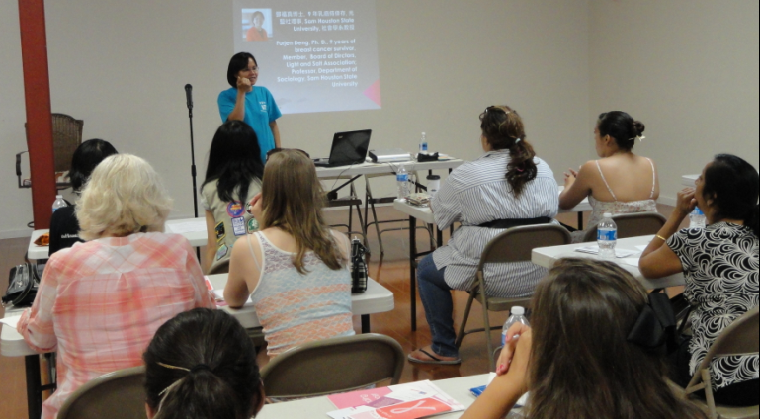

8月12日，光鹽社,華夏中文學校,及Susan G Komen 休士頓分會共同舉辦青年乳癌預防健康講座 (Breast Cancer Education to the Youth, Cosponsored by Hua Xia Chinese School and Komen-Houston Affiliate) 。

Slide 16
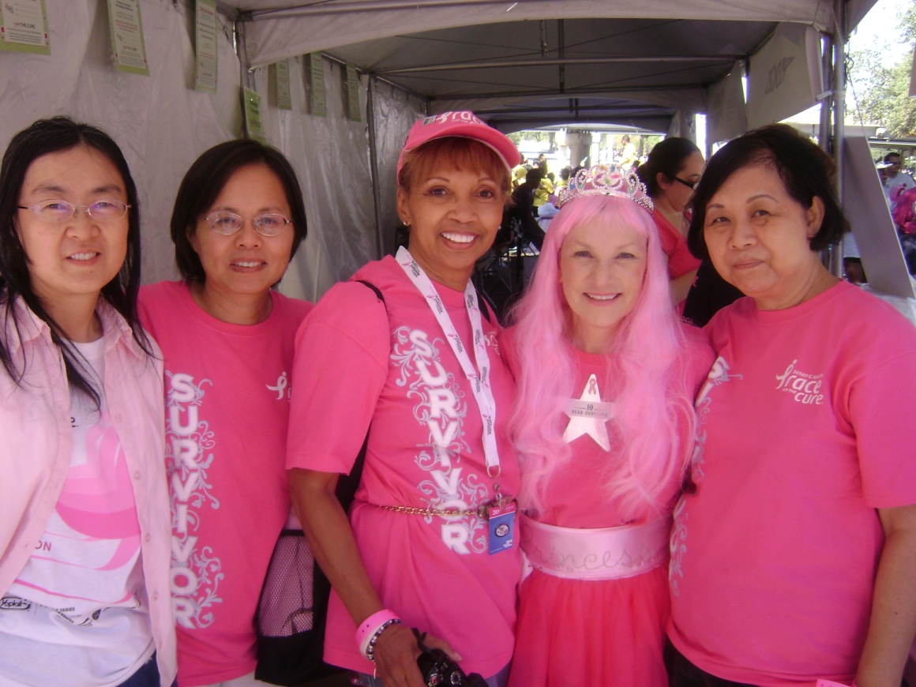


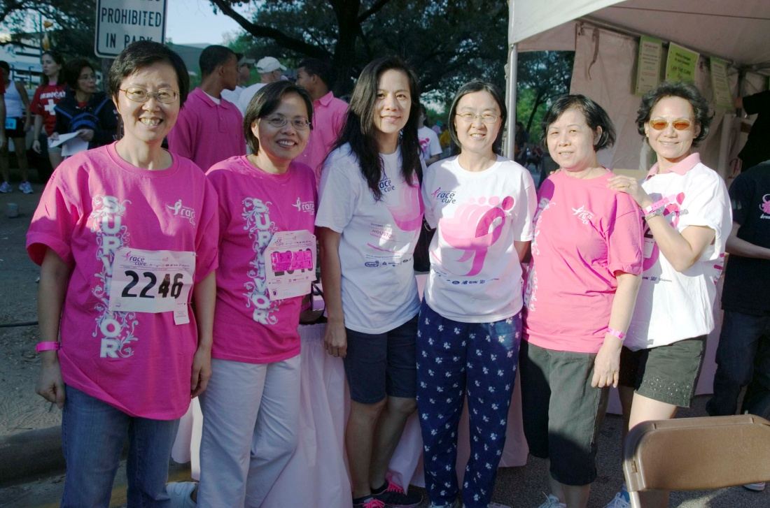

Slide 17
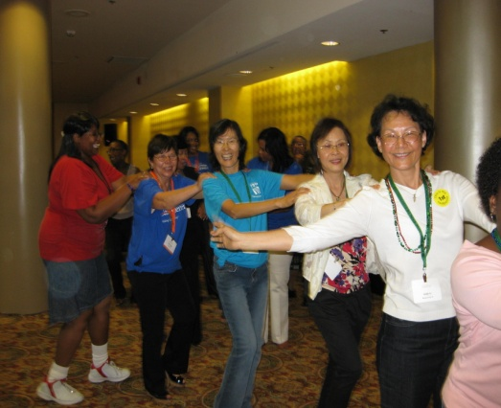
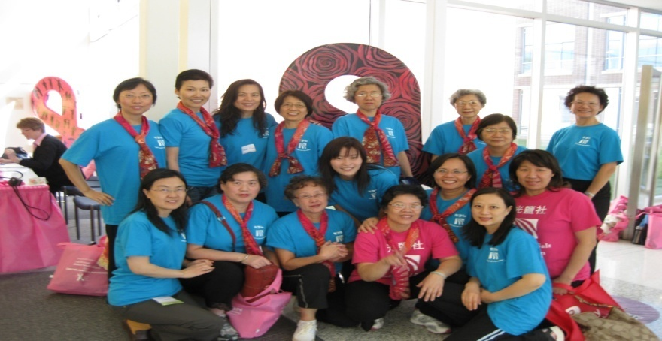
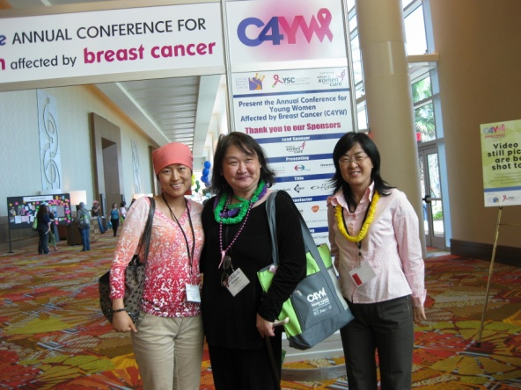
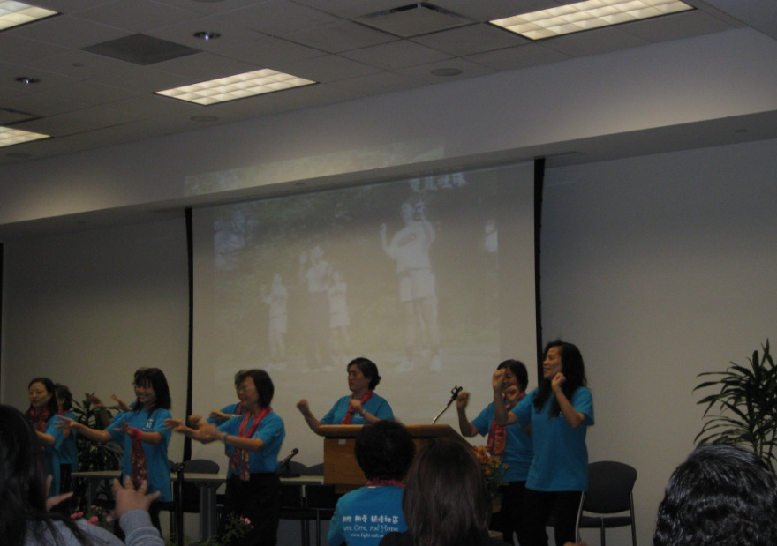
MD Anderson Survivorship Conference 於九月十六日及十七日在西區Omni Hotel 舉行
10月 20至21日, 姊妹們在2011 Texas Breast Health Summit表演五行健康操 (Exercise Program)

Slide 18
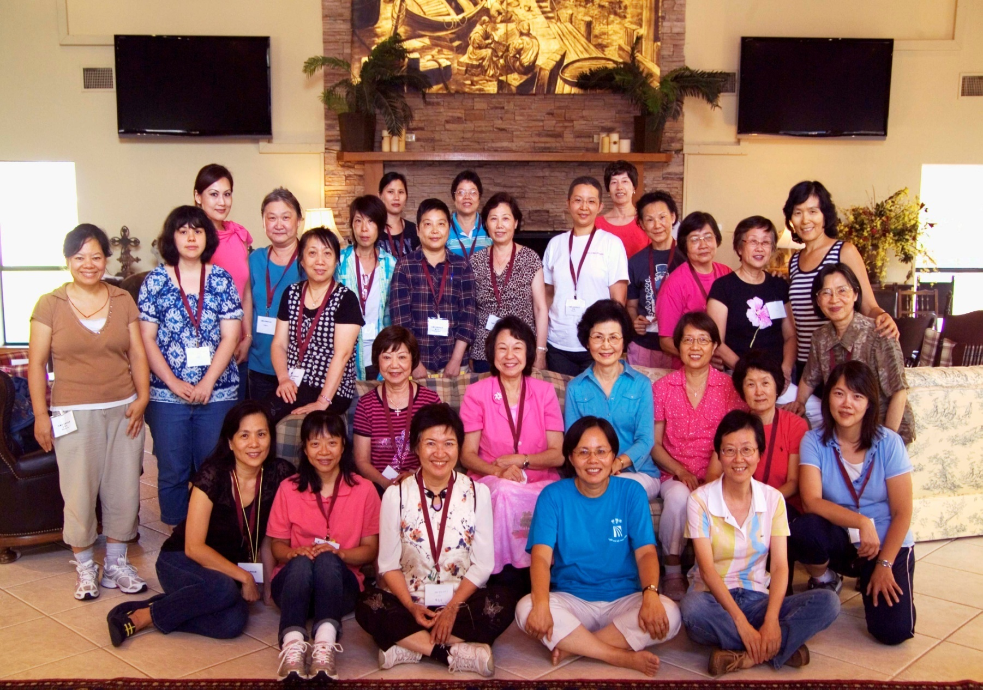
8月26至28日，快樂營 (Survivorship Camp, Aug. 26 -28)

Slide 19
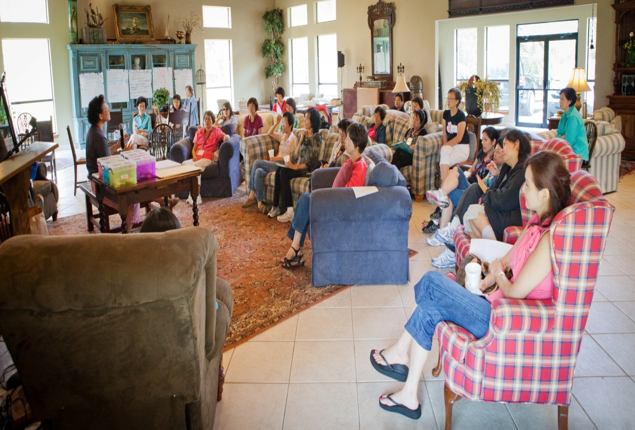
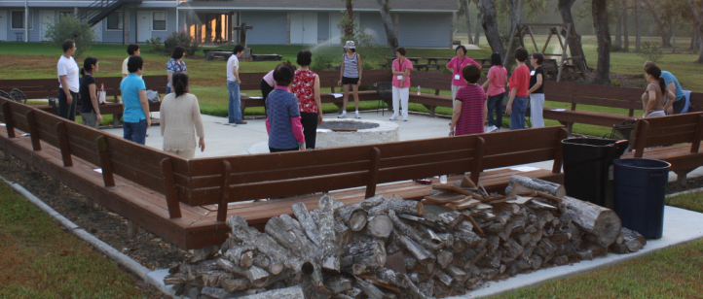

Slide 20
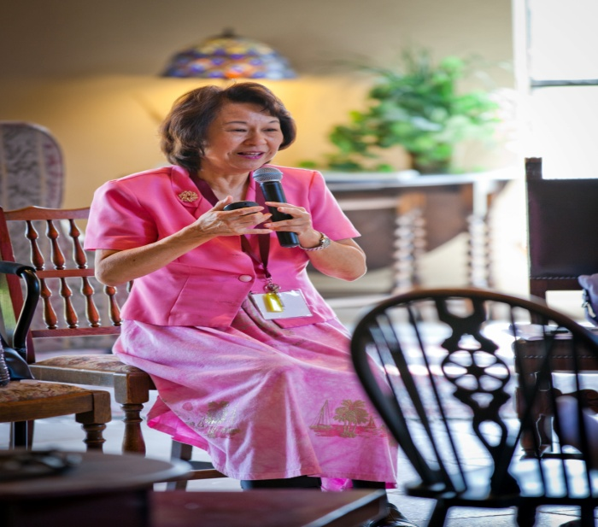
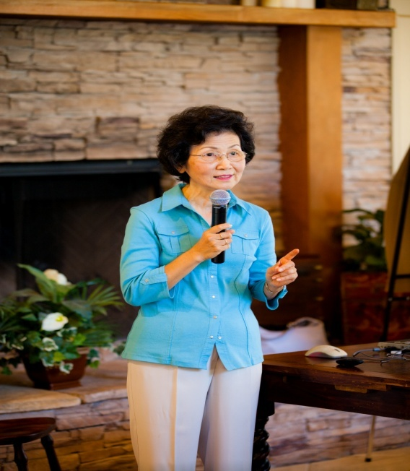
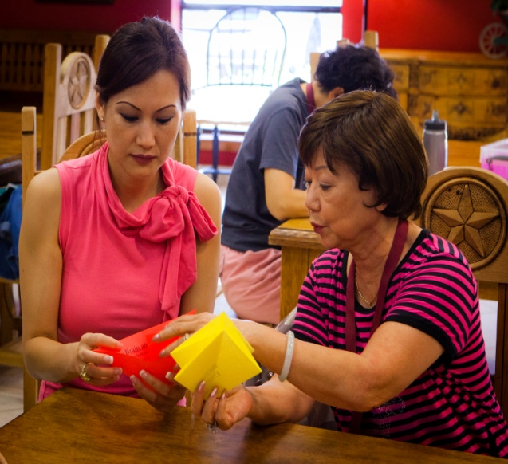
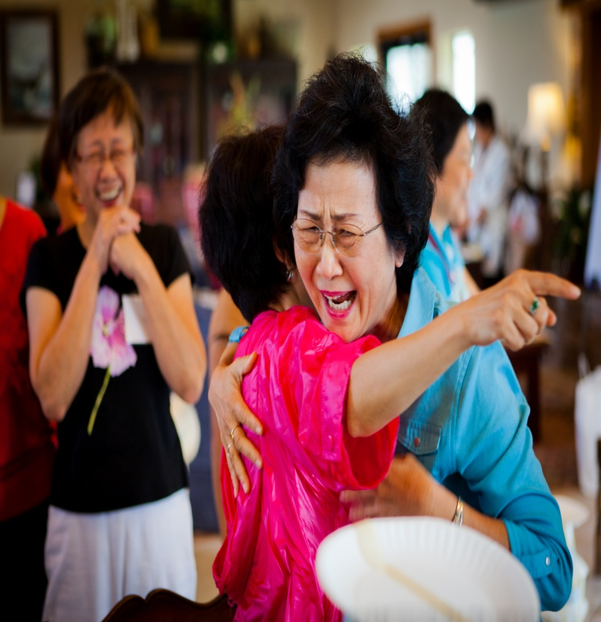
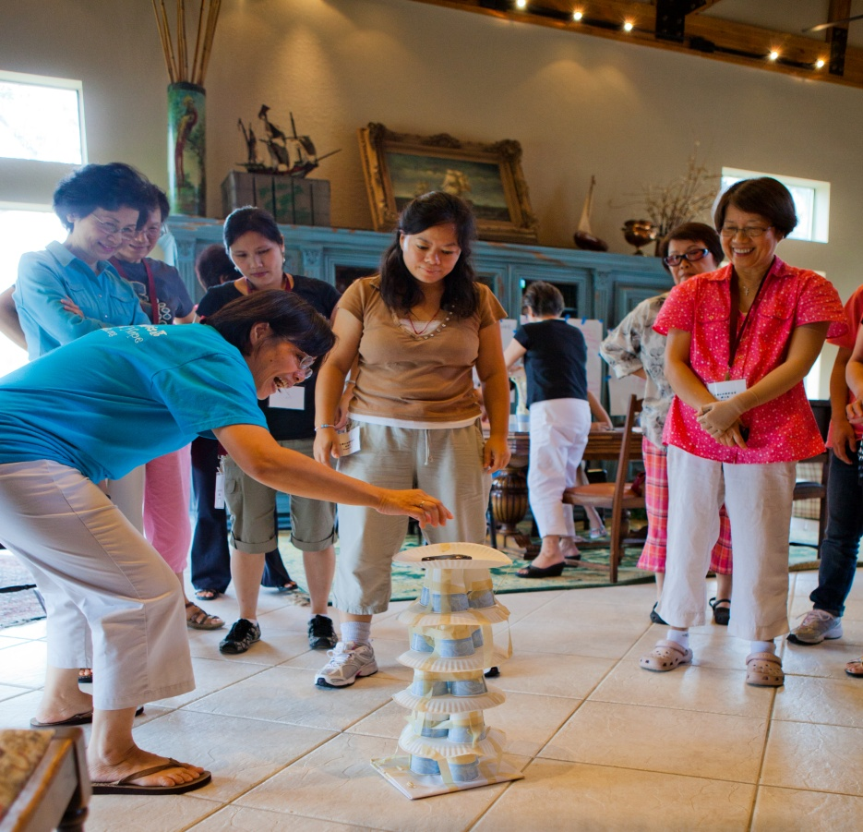
蘇菲雲博士, Speaker: Dr. Esther So)

Slide 21
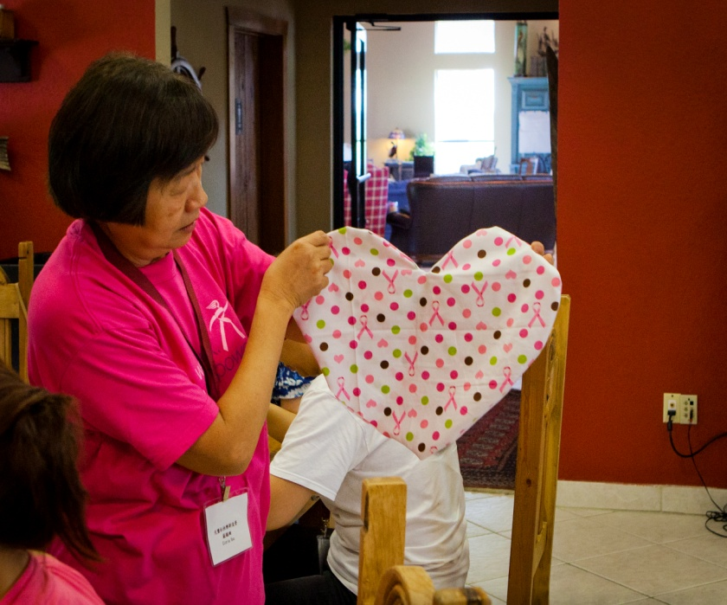
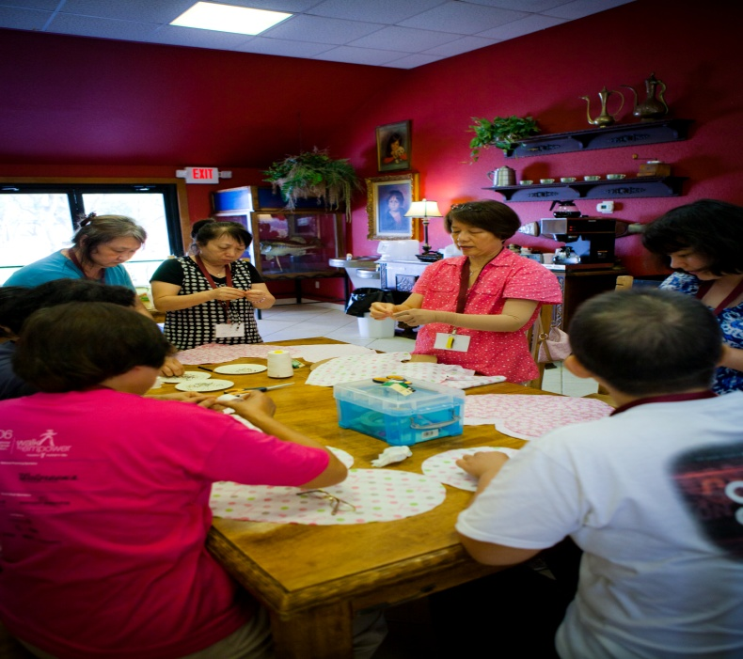
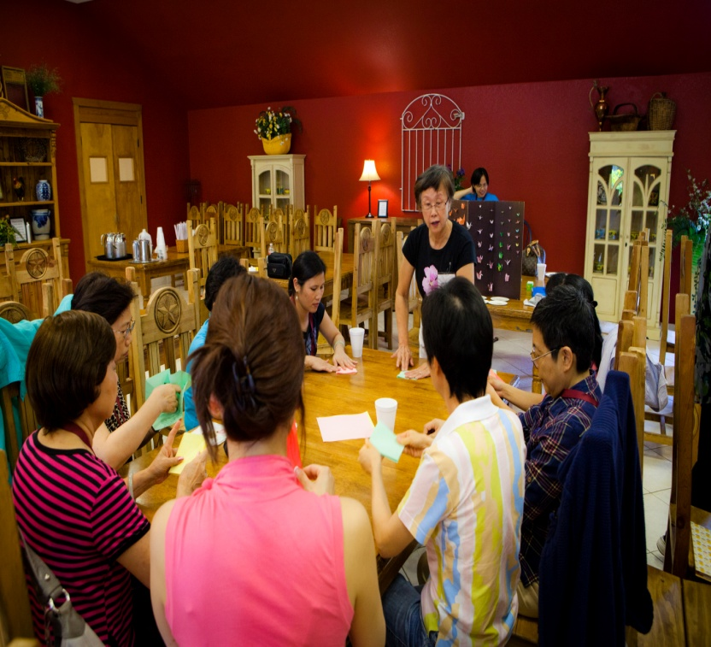
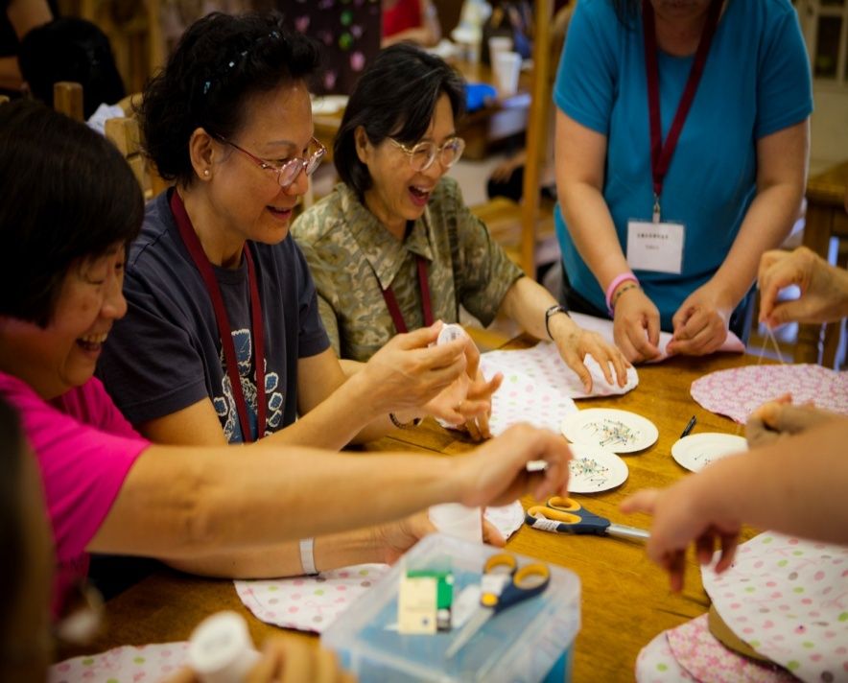

Slide 22
癌 症 篩 檢
(Cancer Screenings)
免費乳房攝影
(Mammogram Screening)
Ｂ型肝炎篩檢
(Hepatitis B Screening)

Slide 23
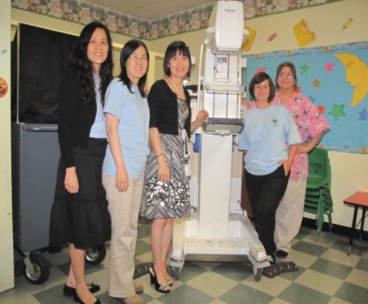


文化中心
文化中心
文化中心
曉士頓中國教會, Houston Chinese Church
Ｂ型肝炎篩檢 (Hepatitis B Screening)

Slide 24




福遍中國教會 (Fort Bend Community Church
曉士頓西區中國教會 (West Houston Chinese Church

Slide 25
防癌教育宣導
(Cancer Prevention Education)

Slide 26



4月16日曉士頓中國教會舉辦一年一度健康日
Houston Chinese Church-Health Fair
6月4曰辦公室同工們参加曉士頓西區中國教會健康 日 Iwest Houston Chinese Church Health Fair)

Slide 27

年長關懷 (Senior Care)

Slide 28



探訪 /Visited Westchase Health and Rehabilitation Center

Slide 29


老人協會表演山地舞
Westwood Rehabilitation Healthcare Center探訪老人
福遍中國教會青年團契 (Fort Bend Community Church-Youth Group)

Slide 30




福遍中國教會青年團契 (Forth Bend Community Church-Youth Group)

Slide 31




曉 士頓中國教會青年團契
Houston Chinese Church –Youth Group

Slide 32

特殊需要關懷中心
(Special Needs Caring Center)

Slide 33




專題講座
(Seminars)

Slide 34




月聚會
(Monthly Support Group Meetings)

Slide 35








Slide 36



兒童教室
(Children Programs)

Slide 37



音樂教室
(Music Classes)

Slide 38





光鹽社特殊需要家庭關懷中心於10/29在華人聖經教會舉辦了一場非常成功的音樂會

Slide 39



手鈴隊與休士頓兒童合唱團交流
社區宣導
與支持 (Community Outreach)

Slide 40
Radio Program
(心靈加油站)
AM 1320
Monday to Friday 10:30 to 11:00 am

Slide 41



主持人: 李論師母 和戴秋月師母

Slide 42





Slide 43





Slide 44



同工合照
同工合照
同工合照
http://fly1320.webnode.com
2009年 3月 17日開播
同工合照

Slide 45




工作團隊 (Team Member)

Slide 46



新聞部義工
麥希真牧師及師母
義賣籌款

Slide 47




西北辦事處
Northwest Branch Office
光鹽社西北辦事處主任余南燕姊妹 (Director Ms. Tina Yu)

Slide 48





Slide 49



光鹽社-健康園地 (Veggie Farm)

Slide 50





Slide 51





Slide 52





Slide 53








Slide 54

社區關懷
(Community Services)

Slide 55


休士頓基督教團體聯合發起 “日本地震及海嘯”賑災籌款 (Participated in Japanese earthquake relief efforts)
陈文律师 (Jessica W. Chen) 提供免费法律咨询 (Free legal consultation, every Tuesday)

Slide 56


7月2日，光鹽社10多位義工和手鈴隊協助 愛心組織 (CARE) 籌款購買學用品 (Participated in fundraising event for CARE-Chinese American Relief Efforts)。

Slide 57






Publications (出版物)
(Website, Monthly Newsletter, Bilingual Educational Materials)

Slide 58
  Funders (計劃補助機構)
  Susan G. Komen-Houston Affiliate
  Cancer Prevention & Research Institute of Texas
  Asian American Health Coalition/Hope Clinic
  City of Houston, through Houston Foundation
  Chinese American Relief Efforts (CARE)
  Chinese Community Center-Senior Employment Program
  United Way
  Asian Cancer Council
  The Lymphoma and Leukemia Society
  Houston Chinese Church
  Fort Bend Community Church
  West Houston Chinese Church
  Chinese Baptist Church
  Tallowood Chinese Baptist Church
  Northwest Chinese Baptist Church

Slide 59






Slide 60
Collaborating Agencies (合作交流機構)
Hope Clinic
Center for Faith and Health Initiative
The Rose
Susan G. Komen for the Cure-Houston Affiliate
ACS- Asian Cancer Council
Lymphoma and Leukemia Society
CanCare
Chinese Community Center
Taichung Kaihui Association
Global Chinese Breast Cancer Support Organization Alliance
Houston Chinese Church
West Houston Chinese Church
Fort Bend Community Church
Formosa Evangelical Church
Northwest Chinese Baptist Church
Chinese Bible Church

Slide 61
Our Team
(我們的團隊)

Slide 62



Slide 63




Slide 64
團隊羣 (Our Team)

